Slide 1
Ananthagiri Hills Camping
Explore Nature and Adventure

Slide 2
Gateway to Adventure and Serenity
01
02
03
04
Home
Our Services
Activities
Contact Us

Slide 3
01
Home

Slide 4
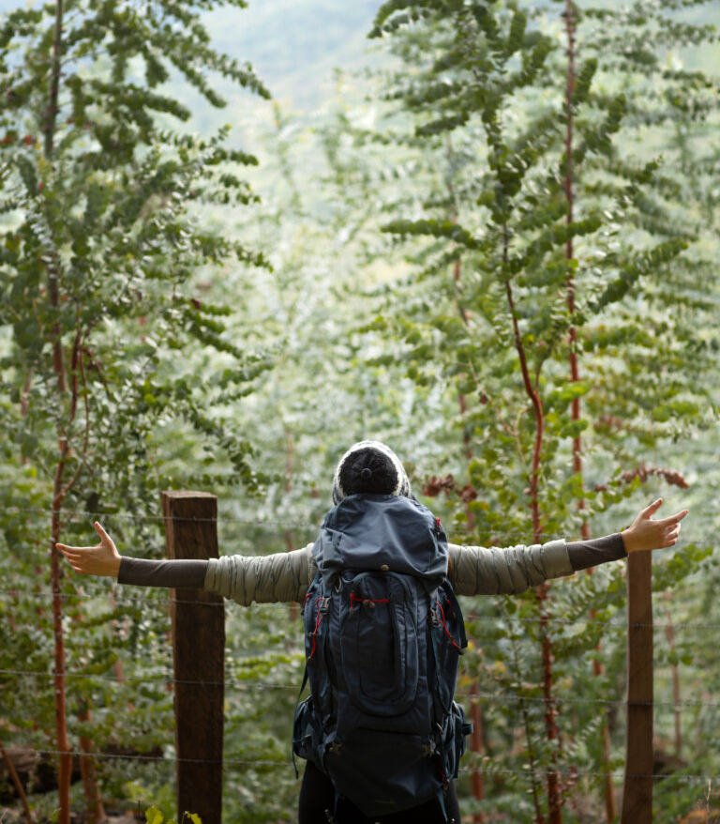
Explore The Wonders
Discover a paradise nestled in the heart of nature of AnanthagiriHills . Immerse yourself in the wonders that await you in this serene haven. From breathtaking landscapes to thrilling adventure activities, there's something for every nature enthusiast.
Breathtaking Landscapes
As you step into, you'll find yourself surrounded by breathtaking landscapes that seem like a canvas painted by nature itself. Lush greenery, meandering trails, and the crisp mountain air create an ambiance of unparalleled serenity. The hills, adorned with vibrant flora, invite you to explore their hidden wonders.

Slide 5

Our Services

Slide 6








Tailored for Your Comfort
Camping
Campfire
Barbeque Grills
Breakfast
Meals &Dinner
Outdoor Games
Star Gazing
Parking Available

Slide 7

Activities

Slide 8
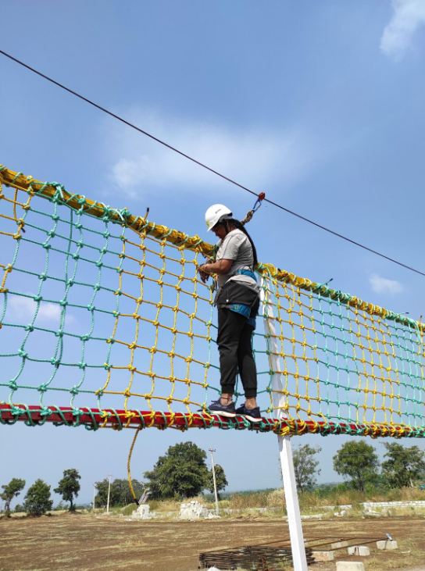
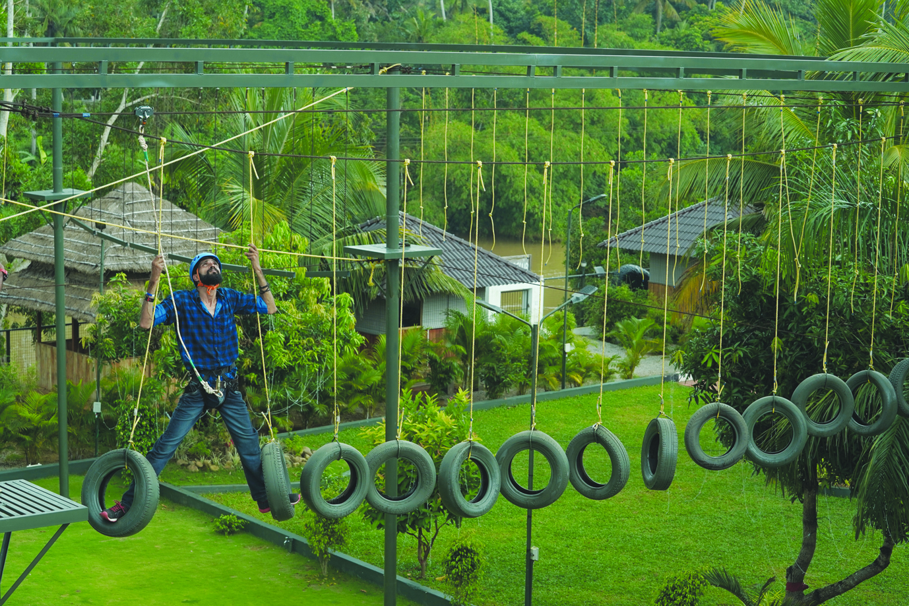

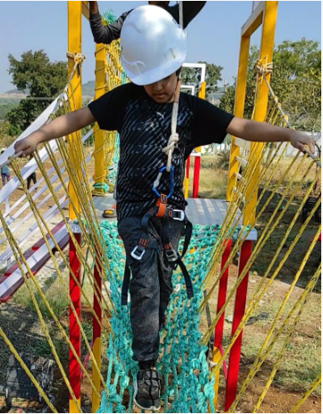
Exciting Activities For All
Double Rope
Tyre walk
Net Climbing
Burma Bridge

Slide 9
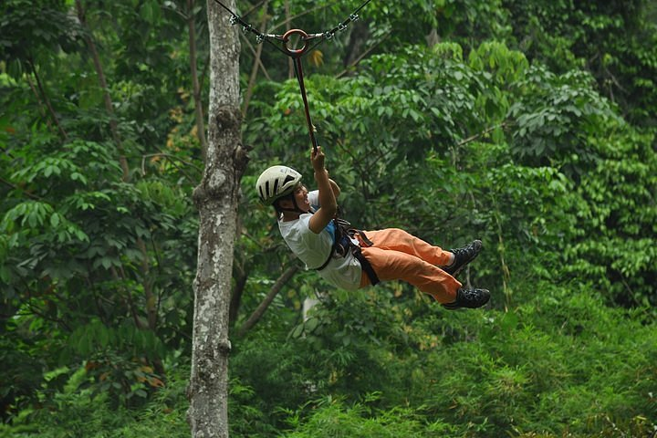
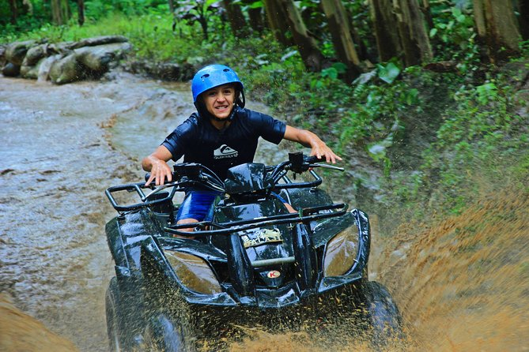

Hanging Rope - Zip lines
ATV Quad Bike
Outdoor games

Slide 10

Contact Us

Slide 11



Get in touch
Phone :7978487988,9347123245
Plan your Ananthagiri Hills Experience
Email:ananthagirihillscamping@gmail.com

Slide 12
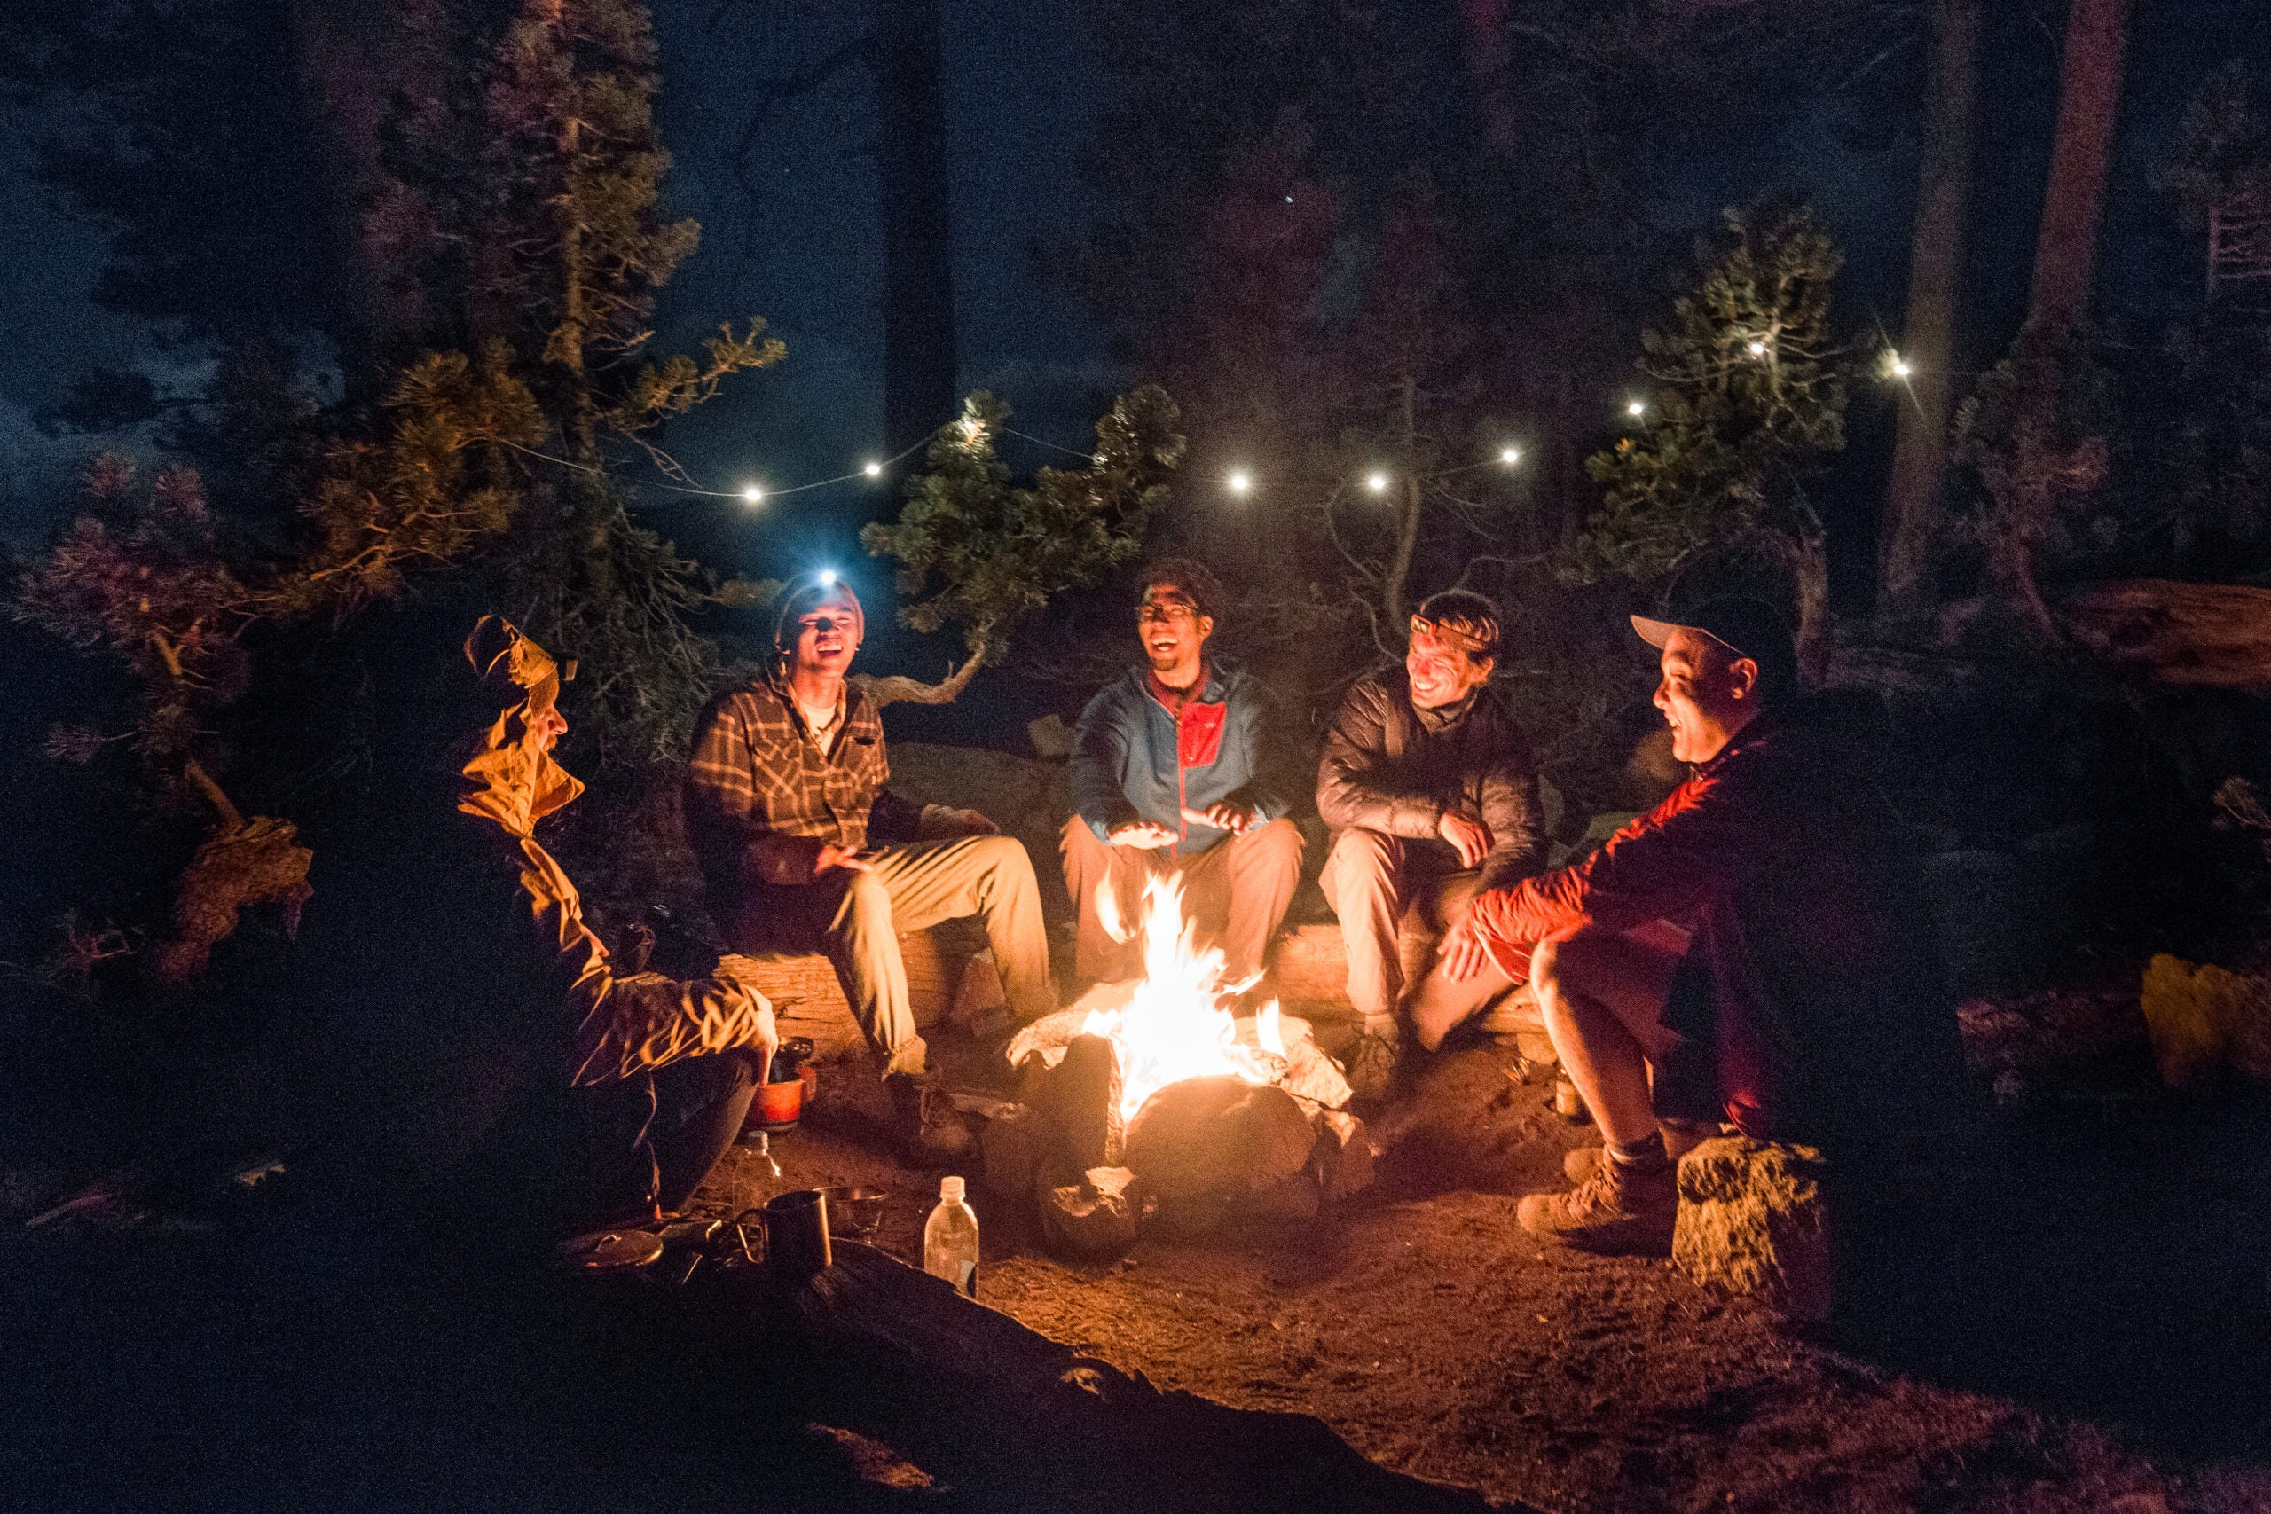

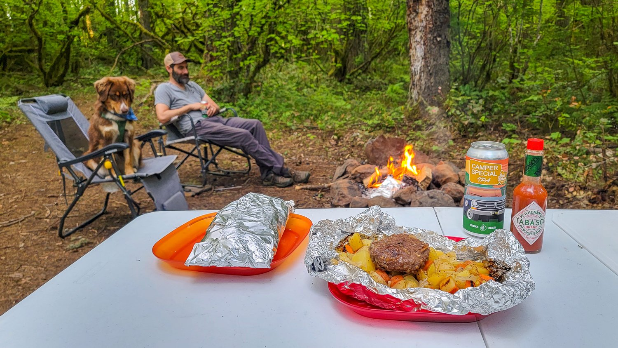
Unforgettable Moments

Slide 13
Pricing-Ticket Information
Affordable Packages for all
Adults - ₹2000 per person | Embark on a journey of nature with our exclusive adult ticket priced at ₹2000. This ticket grants you access to a plethora of experiences.
Children (5 to 14 Years) - ₹1000 per child | Children aged 5 to 14 years can join in the adventure at a special rate of ₹1000.

Slide 14
Terms & Conditions
1. Participants are advised to wear sports attire or sports shoes for adventure activities.
2. Arrival 10 minutes prior to schedule to enjoy the experience.
3. Late arrivals may miss the meals/dinner.
4. We are not liable for loss , damage or injuries sustained by guests.
5. Vehicles are not allowed near the camping tent ; parking is free but at the owner’s risk.

Slide 15
Extra Charges
Enhance Your Experience with extras
BBQ is available for only on Saturday , chicken 600 per kg , Paneer per kg.
ATV Ride for : ₹ 500 for 2 Laps
Zipline: ₹200
Horse Ride: ₹ 100
Bullock Cart Ride: ₹50

Slide 16
Inclusions
A Sneak peek into your adventure
Night Camping
Indoor & Outdoor Camping
DJ Music
Breakfast & Dinner
Campfire
Trekking
Cycling
10 Adventure Activities

Slide 17

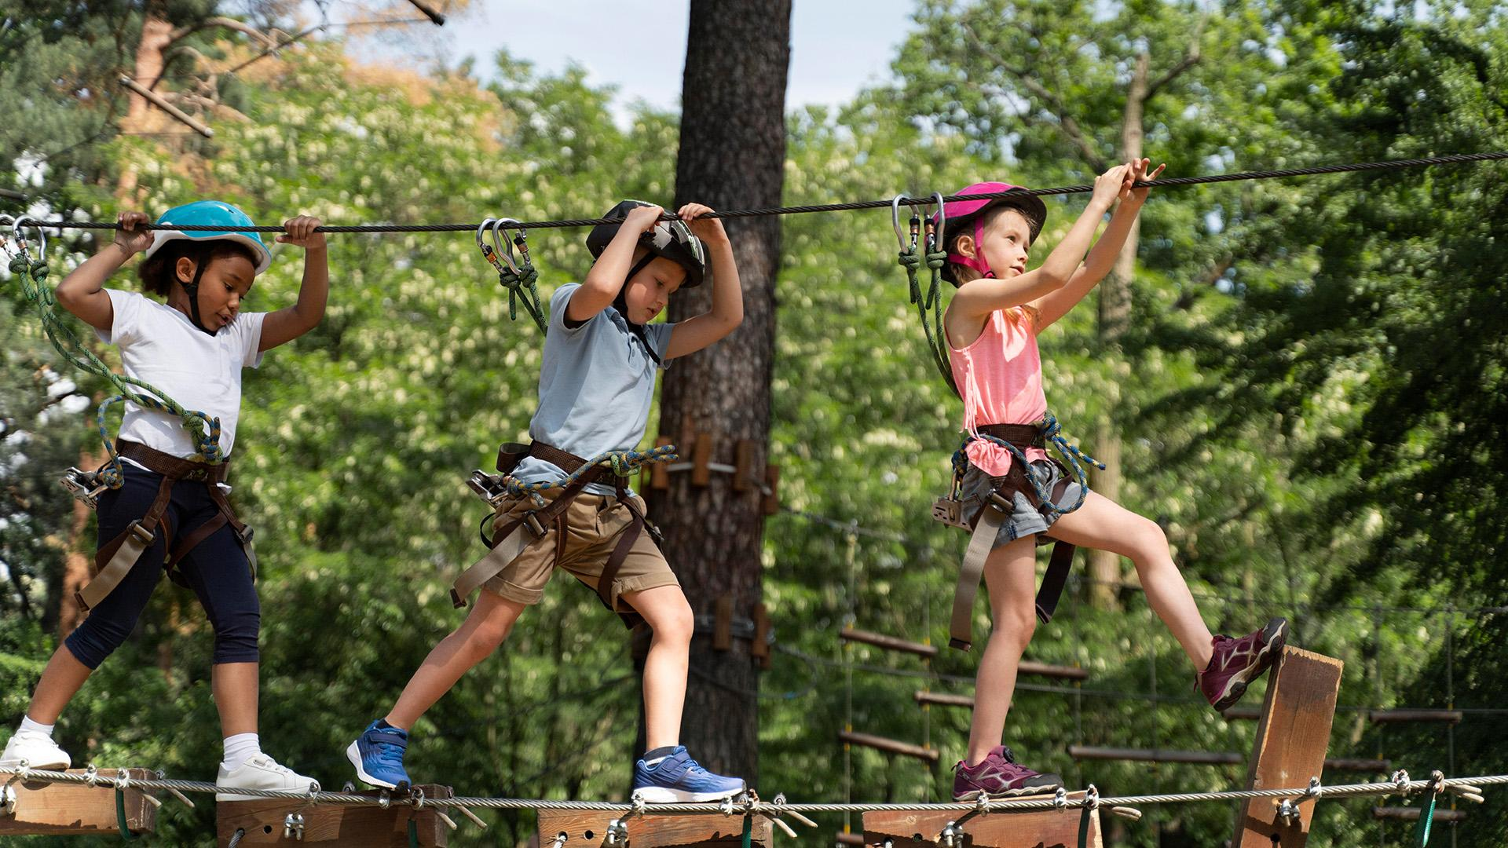

Life’s moments
Don't let life's special moments slip away - capture and preserve them through photographs.

Slide 18
Plan Map: From Check-in To Checkout
01
02
03
04
Check-in 04:00PM
Camping Site
Activity Zone
Campfire Area
05
06
07
08
Trekking Trail
Amenities Zone
Food Area
Check-out 11:30 AM

Slide 19
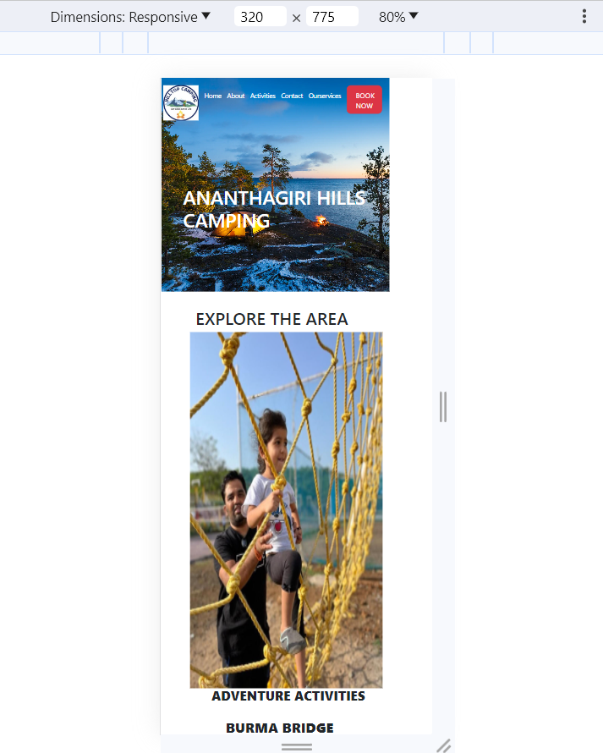
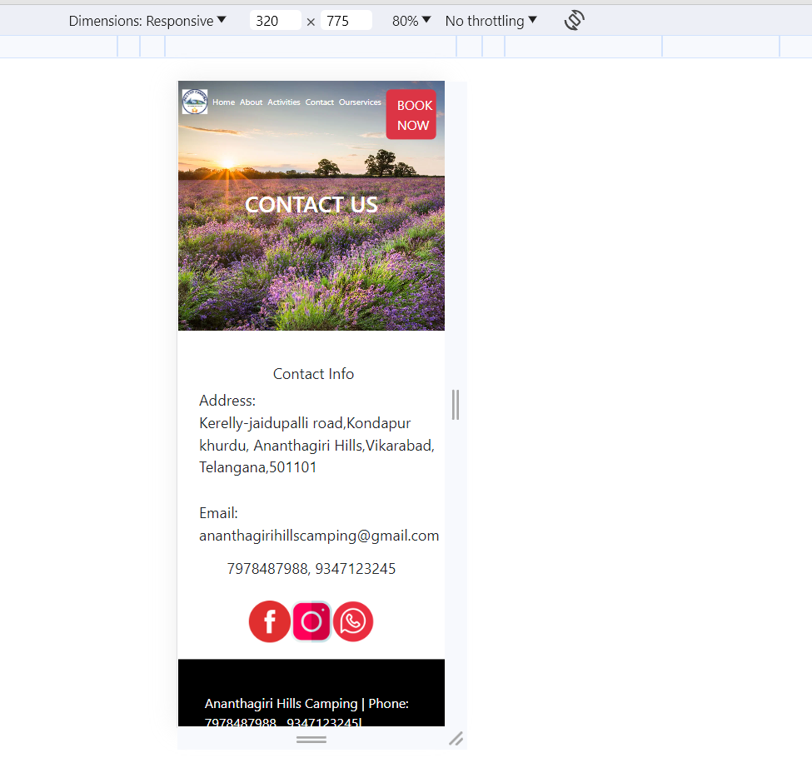
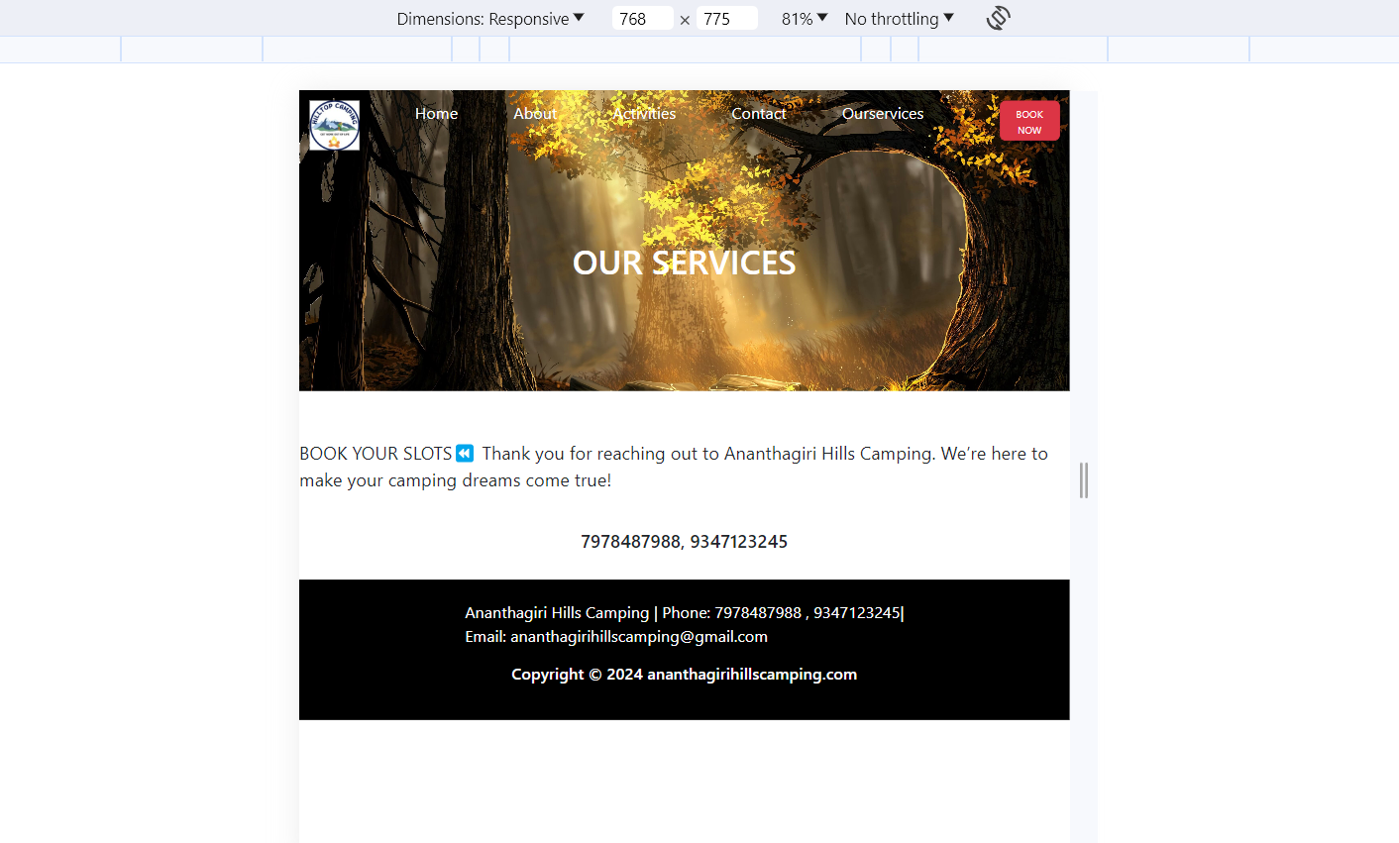
Seamless Viewing Across Devices
Ensuring an impressive display on Mobiles, Tablets and more.

Slide 20
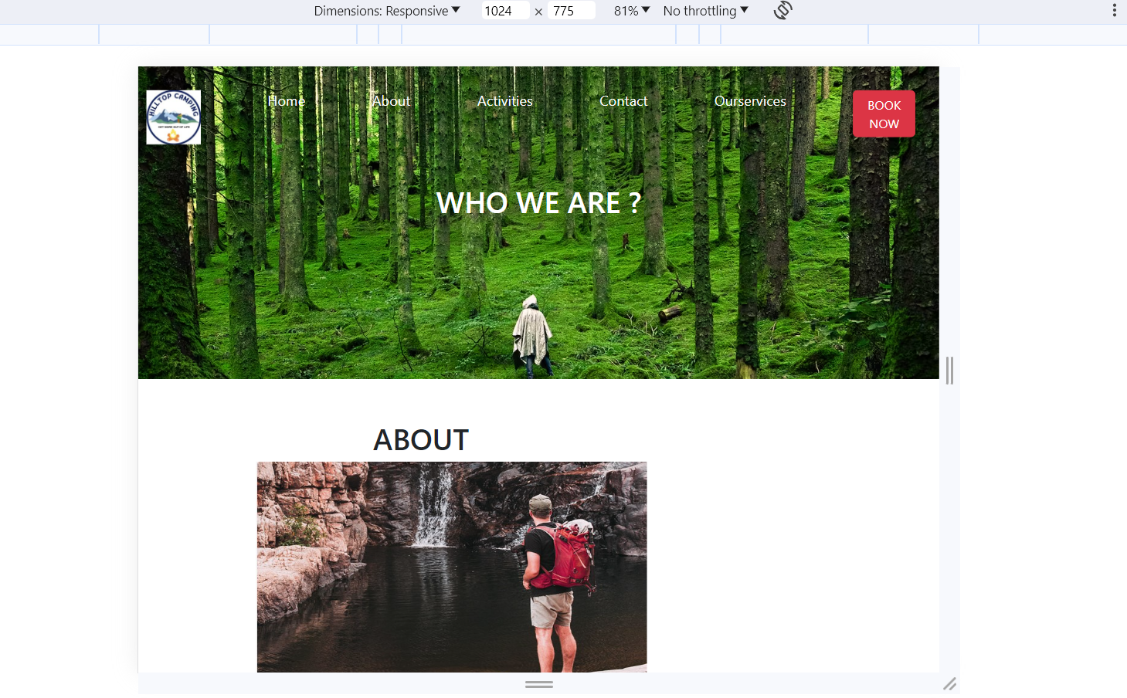
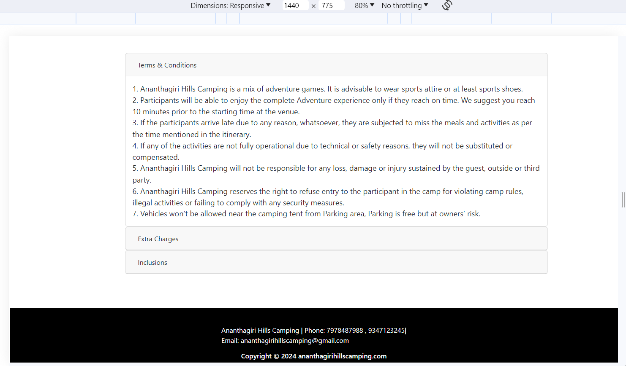
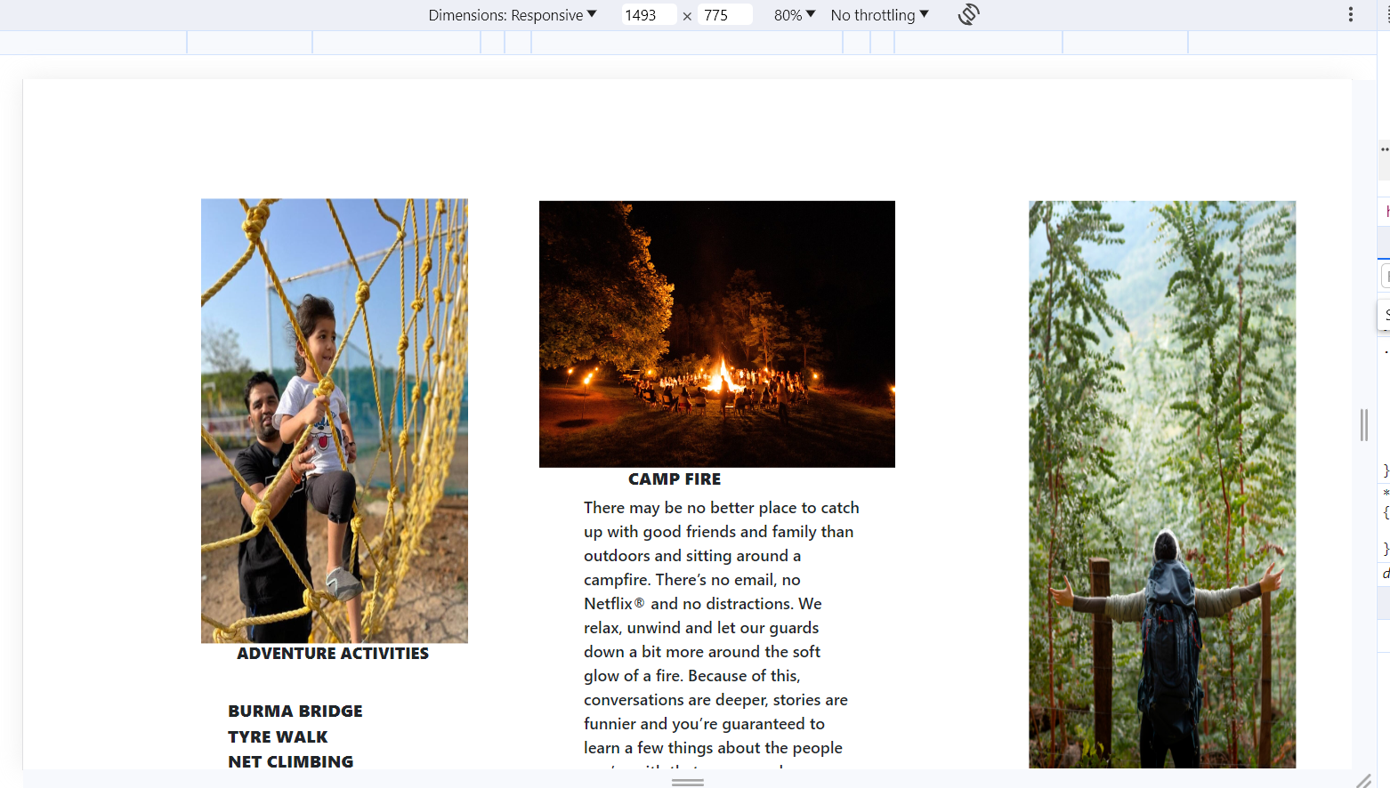

Slide 21

Thank You

